Slide 1
LEADERSHIP & ADVOCACY Coaching
Session 3 For Leaders

Slide 2
Project Timeline
✓
✓

Slide 3
Desired Outcomes Session 3
Refine skills for further understanding, key information about Engagement & Active Listening and their link to Family Success Center Culture and Practice Profile
Understand Leadership and Advocacy for Family Success Centers
Connect coaching skills to Leadership and Advocacy applying the Coaching Compass
Seek the Issue
Clarify Thinking
Contribute
Push for Action
Directors/Leaders will have an opportunity to learn and apply the fundamental aspects of Leadership and Advocacy as defined by the Practice Profile
Make a plan for application: Use skills/self-directed learning to teach FSC Staff about Leadership and Advocacy

Slide 4
Agenda
8:30 Registration
9:00 Welcoming – Introduction to the Day
9:20 Foundational Recap
10:05 Leadership
10:30 Break
10:40 Exploring Leadership
11:35 Exploring Advocacy
12:30 Lunch
1:00 Debrief / Frame out afternoon
1:10 Coaching Practice
2:20 Break
2:30 Application/Self-Directed Work
3:10 Wrap Up
3:30 Adjourn

Slide 5
Working Agreement
Our Agreement from last session
These are our commitments to each other to have a successful day
Please add anything additional to make this a great environment
Utilize the Thought Sheets in front of your table
Parking lot

Slide 6
Completion Survey
Your Feedback

Slide 7
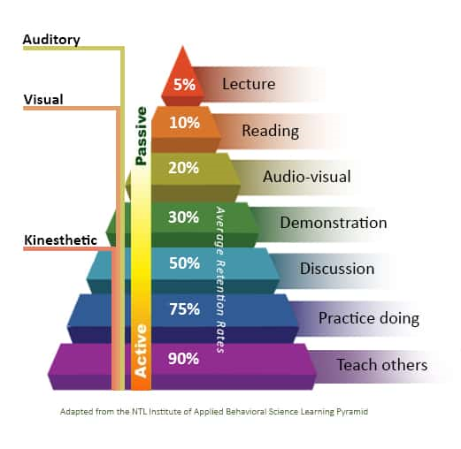
Increase Retention, Recall, and Application
Visual
&
Kinesthetic
How Do you reach Behavioral Change?
How do you reach Retention and Recall?

Slide 8
Listening
Presence

Slide 9
Reflecting Back…
What did you experience when you practiced Engagement and Active Listening?
What worked well?
What questions did you have regarding your practice?
What do you think could have enhanced your practice?

Slide 10
Let’s Recap!

Slide 11
LEADERSHIP

Slide 12
What does Leadership look like in your FSC?
FSCs engage families, individual family members, and community partners in leadership activities within Centers.
Community strategies that promote child protection focus on creating a shared belief and collective responsibility to protect children from harm and expand the range of services and supports available to families and individual family members (Daro & Dodge, 2009).

Slide 13
What can be expected at any FSC?
1
2
Expected Outcomes
Practice Profile Definition
SUCCESS

Slide 14
Leadership - Expected
Involves individuals, families, and community partners through a formal process in making recommendations about the Center’s programs/services. Actively involving families and individual family members can promote more tailored and customized delivery of the program (Kirby & Sanders, 2012, 2014; Metzler, Sanders, Rusby, & Crowley, 2012). The goal is to enhance the fit of the programming within the context (Sanders & Kirby, 2014).
Families, individual family members, and community partners lead efforts within the Center (i.e. co-leader of an advisory board, co-leader in community outreach efforts, leader of a program within the Center). Families and individual family members within a community are not just recipients of outcomes; they are also makers of outcomes achieved. Therefore, it is critical to “recognize and respect there are assets that community families and individual family members bring to an initiative” (Barnes & Schmitz, 2016).
Proactively builds the leadership skills of FSC families and individual family members to ensure meaningful participation in leadership activities and recommendations for the Center’s programs/services. As families and individual family members “become engaged in service planning process, they can empower themselves to assume ownership of the process and make personal investments in their community” (Daro & Dodge, 2009).

Slide 15
What can be expected at any FSC?
1
2
Expected Outcomes
3
Behavioral Indicators
Practice Profile Definition
SUCCESS

Slide 16
Leadership - Prioritized Behavioral Indicators
Creates a formal process to receive recommendations for the center
Elicits recommendations from members through mix of methods including consultative conversations and instruments to gather feedback
Offers appreciation to members for contributing their views by communicating back to them about how their recommendations were instilled into practice
Networks in the community to recognize potential leaders
Recruits and selects potential leaders to the leader positions at the center according to their strengths and interests
Provides continuous support to co-leaders as needed, particularly when delegating
Builds empowerment by coaching the co-leader through decision making considerations
Assesses leadership strengths and needs of members who will participate in leadership activities
Coaches the member to become aware of their strengths and how to apply them
Provides training to member on the procedures and functioning of the particular aspect of the FSC that the member is going to be leading

Slide 17
10

Slide 18
Exploring Leadership
Leadership in practice
Prioritized behavioral indicators
Family and community partner perspective on top indicators
Factors influencing family and community partner choice
What needs to change
Contributing factors

Slide 19
Discuss
Specific behaviors/actions that led to identified leadership strengths
Specific behaviors that could be a challenge and what actions could address
Chart highlights and actions to share

Slide 20
ADVOCACY

Slide 21
What does Advocacy look like in your FSC?
FSCs work on behalf of, in coordination with, and empower families and individual family members to ensure their needs are met. FSCs partner with families and individual family members to support the development of skills to advocate on their own behalf.

Slide 22
Advocacy - Expected
Support and coach families and individual family members on how to access resources or services based on their interests, goals, and needs. Advocacy practices that empower families and individual family members to access resources can facilitate internal motivation of individual and families (Ryan & Deci, 2000).
Connects with external resources on behalf of the member in order to access the needed resources, only when necessary for the family or individual family member (e.g. family member does not have the skills needed, language barriers).
Works with community partners to address barriers to accessing services and resources (e.g. transportation).

Slide 23
Advocacy - Prioritized Behavioral Indicators
Follows practices that create awareness of family and community interests, goals, and needs, within the FSC team/staff
Creates a bilingual coaching strategy to educate families on how to access resources
Coaches and trains families to use resources
Encourages families to use resources, make decisions on their own, while continuing to support them through the process, thereby empowering them
Connects with resources on behalf of the families that have challenges
Partners with community-based agencies to identify community needs and has clear purpose, communication, and agreed outcomes
Collects information on challenges and barriers to services faced by families
Identifies & prioritizes barriers that can be addressed by FSCs or FSC partners
Formalizes a mechanism for awareness among FSC team members, and volunteers regarding the newly found solution

Slide 24
Exploring Advocacy
Advocacy in practice
Prioritized behavioral indicators
Family and community partner perspective on top indicators
Factors influencing family and community partner choice
What needs to change
Contributing factors

Slide 25
Discuss
Specific behaviors/actions that led to identified advocacy strengths
Specific behaviors that could be a challenge and what actions could address
Chart highlights and actions to share

Slide 26
Leadership & Advocacy Gallery

Slide 27
Lunch
30

Slide 28
Welcome back! Leadership and Advocacy
As we get prepared for lunch, we just wanted to share what we have to look forward to in the afternoon.
We will spend time exploring Active Listening and opportunities to practice.
We will do Practice Round Robins to pull together both Essential Functions for application and transfer.
We will go through the Self-directed work to set you up for success when you go back to your centers
Thanks so much for remaining present and being a phenomenal group!!

Slide 29
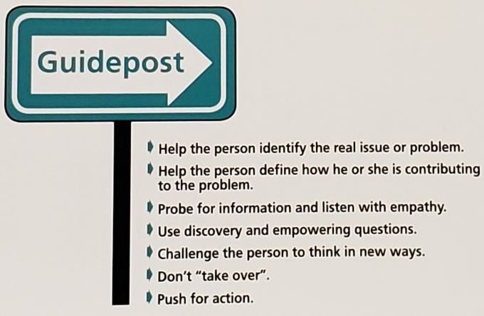
Coaching Compass

Slide 30
Coaching Compass – Seek the Issue
Refrain from concluding without data
Ask Investigative Questions
Listen with Empathy
Paraphrase Content and Emotion
Push for Action
Seek
The Issue
Contribute
Clarify Thinking

Slide 31
Coaching Compass – Clarify Thinking
Seek
The Issue
Clarify Thinking
Contribute
Push for Action
Focus on the Person as well as the Issue
Ask Discovery Questions
Provide Feedback
Probe & Summarize

Slide 32
Coaching Compass - Contribute
Seek
The Issue
Clarify Thinking
Contribute
Push for Action
Share Experiences
Offer Suggestions
Explore Alternatives

Slide 33
Coaching Compass – Push for Action
Seek
The Issue
Clarify Thinking
Contribute
Push for Action
Ask Empowering Questions
Refrain from Taking Over
Ensure Ownership

Slide 34
Coaching Demo

Slide 35
Putting it all together
Coach – Coachee – Observer
All 4 skills will be demonstrated together
When you hear the chime, we will stop action and switch roles
Feedback and report out

Slide 36
Scenario 1
You are preparing for an FSC activity, when a community member comes in the center looking for assistance. You introduce the community member to your family partner and ask him to assist and take the community member on a tour of the center. While taking the tour you over hear that the community member is seeking assistance with housing and but has been having a difficult time connecting with the any resources. You notice that the family partner gives the participant a tour of the center and asks them to sign up for activities at the center and then gives them resource pamphlets for homelessness prior to them leaving the center. How do you coach the family partner to advocate for the family?

Slide 37
Scenario 2
Since the FSC opened their doors they have noticed a real problem with transportation in the area. They are located in a rural area that does not have any bus service. The Center’s family and community partner has been attending the community planning meetings. As you are reviewing the notes of the meetings, you noticed that there has been no discussion of the transportation barriers that exist in the area. How would you make sure that the family partner is working with community providers to access resources?

Slide 38
Scenario 3
As the center is preparing for the next FSC presentation you notice that the same volunteers have been assisting in all the presentations in the past. When you address your concern with the staff, they indicate that the others are not interested and that this is the only volunteer they trust and can count on. How do you ensure that all family members are given equal opportunity to assist or co-lead a workshop?

Slide 39
Scenario 4
The Parent Advisory Board has not had a good turnout for the last few months. When you are discussing with your team you identify that the meetings are normally held the first Tuesday of every month at 10 am. The staff ensures that there is a robust agenda for the meeting and snacks for the participants, yet they have only had one or two community members attending each meeting. How do you coach your staff member to ensure meeting are held at times that are convenient for the community and not the center?

Slide 40
Scenario 5
In discussing the center’s calendars for the upcoming months, your team is excited to bring the yoga instructor back for every Tuesday and Thursday. They talk about what a great job she does and how much better everyone feels after the activity. But you remember that no one has been coming out for yoga and when you look at the sign in sheets for those activities you notice that only staff have been participating in the yoga events. How do you ensure your staff is involving the community in the planning of activities at the center?

Slide 41
10
On a Break!!

Slide 42
Application - Self Directed
Coaching
Facilitator
Leadership
Advocacy

Slide 43
Desired Outcomes Session 3
Refine skills for further understanding, key information about Engagement & Active Listening and their link to Family Success Center Culture and Practice Profile
Understand Leadership and Advocacy for Family Success Centers
Connect coaching skills to Leadership and Advocacy applying the Coaching Compass
Seek the Issue
Clarify Thinking
Contribute
Push for Action
Directors/Leaders will have an opportunity to learn and apply the fundamental aspects of Leadership and Advocacy as defined by the Practice Profile
Make a plan for application: Use skills/self-directed learning to teach FSC Staff about Leadership and Advocacy

Slide 44
Instructions – Section E
A | Behavioral Indicator | B
Here in column A, please assess your staff’s knowledge and skills to engage in this behavior on a scale of 0 (no knowledge)- 3 (complete knowledge) | 1. Creates a formal process to receive recommendations for the center | Here in column B, please assess Your ability to coach your staff to improve this behavior on a scale of 0 (no knowledge)- 3 (complete knowledge)
 | 2. Elicits recommendations from members through mix of methods including consultative conversations and instruments to gather feedback

Slide 45
Assessment

Slide 46
Michele Toscano: Education Program Development Specialist
Sean Murphy: Assistant Director of Practice

